Slide 1
Your Colleague, Jim Stevenson
Past, Present, and Future

Slide 4
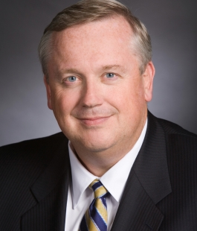

Slide 6
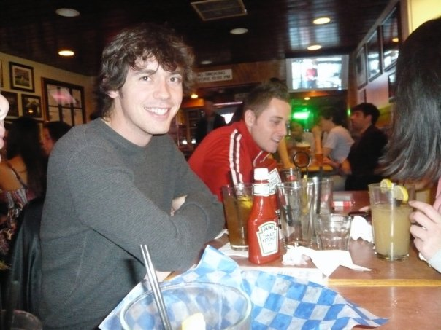

Slide 7
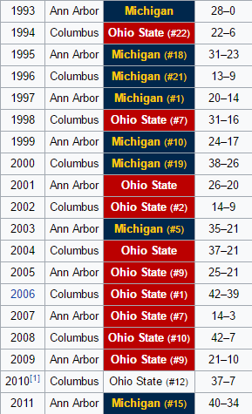
Jim’s undergrad
and PharmD years at M

Slide 9
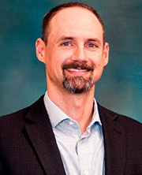

Slide 12
Present
Teaching
Seminar
Psych
Test2Learn
Special Topics/Mentored Research
Resident research
Clinical
Pharmacogenomics Consult
Research: clinical pharmacogenomics
Psychiatric
pgx
CV
pgx

Slide 13
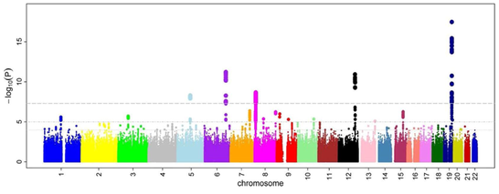
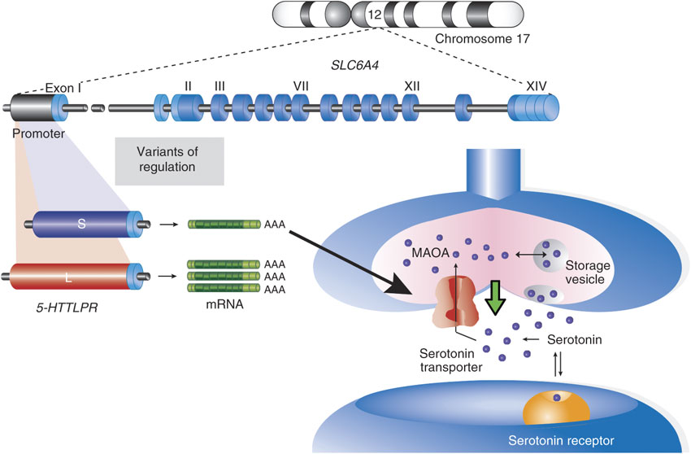
Discovery
Validation
Implementation

Slide 14
Research interests
Skills
Interests
Germline pharmacogenomic association studies (candidate and GWAS)
Observational research
Psychopharmacology
Understanding pgx literature
Not buying snake oil
Psychiatric pgx
Antipsychotics
Antidepressants
Cardiovascular pgx
Antiplatelet
Anticoagulant
Physiologic impact of psych meds
Pgx implementation

Slide 15
Ongoing work
PreCISE-Rx
Outcomes of clinical intervention
Discovery/subgroup analyses
Implementation barriers
AHA Mentored Clinical and Population Research Award
“Serotonin transporter gene polymorphisms, platelet aggregation, and clinical outcomes in ACS patients treated with SSRIs and dual antiplatelet therapy”
VA involvement (developing)
Million Veterans Program

Slide 16
Future Directions
Increased bioinformatics training
Manipulating sequencing data
Epigenetics
KL2 or K08 mechanism

Slide 17
Why you might want to work with me
Brainstorming
Design
Add a pgx angle to your ongoing study
Interpreting your research pgx data
Have pt with pgx results
Interested in psych med’s effect on a physiologic parameter/health outcome
Teaching pgx to providers

Slide 18
The End

